Slide 1

SRM UNIVERSITY, TRICHY
DEPARTMENT OF ELECTRONICS AND COMMUNICATION ENGINEERING
SMART SENSORS FOR AGRICULTURE DEVICES
TOPIC:FINDING SOIL MOISTURE AND HUMIDITY USING Iot
M S SAISANKEET
E G PRADEEP
B PRASANTH

Slide 2
ABSTRACT
The advent of Internet of Things (IOT) technology has revolutionized agriculture by enabling precision farming techniques. This paper proposes an IOT-based agricultural sensor system designed to enhance crop management practices through real-time monitoring of soil conditions. The system utilizes a network of wireless soil sensors deployed across agricultural fields to collect data on key parameters such as soil moisture, temperature, pH levels.

Slide 3
INTRODUCTION
Smart farming technologies have empowered farmers which help them to compete with significant problems they face through much better remedies. The growth pattern and environmental parameters of crop growth provide scientific guidance and optimum countermeasures for agricultural production. The proposed system uses a IOT and an array of sensors LIKE pH sensor, and capacitance dielectric soil moisture sensor, and is more accurate than existing systems in tracking the soil contents and the security of the crops.

Slide 4
MOTIVATION BEHIND THIS PROJECT
With IOT technology, farmers can remotely monitor soil conditions from anywhere using smartphones or computers. This capability allows for timely interventions and adjustments, even when farmers are off-site. Main aim of this project is to reduce the human labour and the data’s of the soil moisture and humidity can be accessible world wide using internet connection.

Slide 5
COMPONENTS USED
Soil sensor
Humidity sensor
Transistor
PCB board
Wi-Fi module
LCD Pannel

Slide 6
PROPOSED METHODOLOGY
Sensor Selection: Choose appropriate sensors for measuring soil moisture and humidity. Capacitive soil moisture sensors and DHT series sensors (such as DHT11 or DHT22) are commonly used for this purpose.
Alerting System: Implement an alerting system to notify users when soil moisture or humidity levels deviate from predefined thresholds. You can use email notifications, SMS alerts, or push notifications through a mobile app.
Data Transmission: Use an IoT module (like ESP8266 or ESP32) to transmit the sensor data to the cloud. You can use protocols like MQTT or HTTP to send the data.
Data Interpretation and Action: Based on the analyzed data, take appropriate actions such as adjusting irrigation schedules, activating sprinkler systems, or notifying farmers to take corrective measures.
Integration with Other Systems: Optionally, integrate the soil moisture and humidity data with other agricultural systems, such as weather forecasts or crop management software, to enhance decision-making processes.

Slide 7
EXSISITING METHODOLOGY
https://youtu.be/nqrbCnzTrDM?si=f0tCL1Xk6nWQu3_I
Previous projects based on this topics are just done using Arduino and using DC motors and many no connecting wires. This may lead to the malfunctions when wired gets lose or may get disconnected and that can be run only through push button after coding's get inserted. But now coding's gets reduced and a temporary web link has been created and that can be accessible through mobile applications all over the world just by using the internet connections. Further we can develop permanent web page using HTM CSS JAVA and that can be linked through Arduino IDE and it can be used permanently.

Slide 8
SOFTWARE USED
Arduino IDE
Temporary Web page

Slide 9
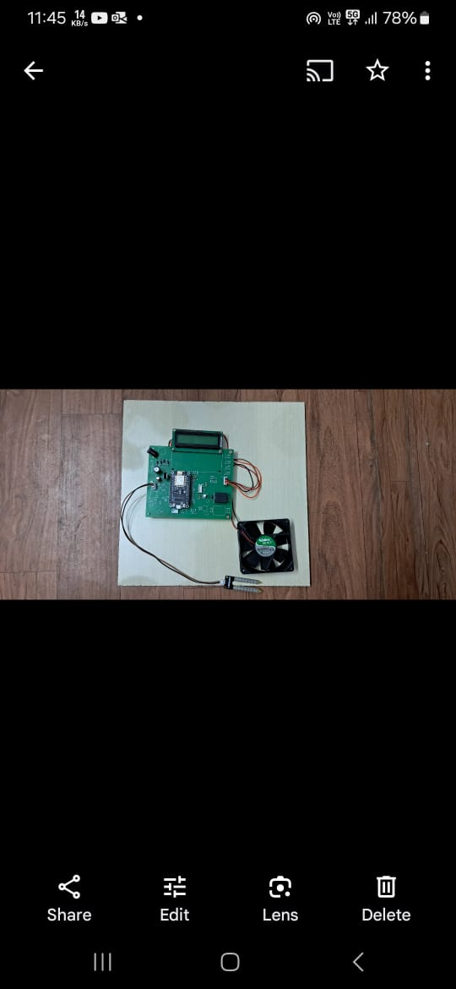
CIRCUIT DIAGRAM

Slide 10
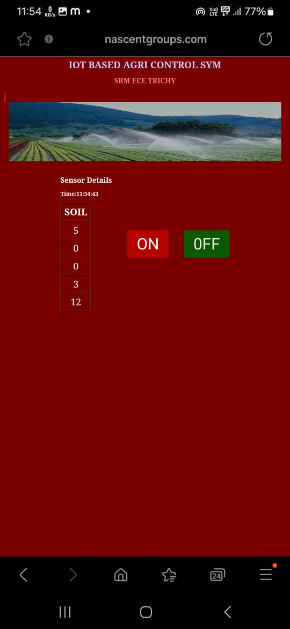
OUTPUT

Slide 11
RESULTS
Thus by running this project using coding’s we get output as mentioned in the above slide. Here instead of urea or fertilizer supply we are using water as resource to soil moisture. So coding has been alternated based on it and destinated output has been derived.

Slide 12


